Slide 1


Slide 2
A VISUALIZATION OF TORONTO NEIGHBOURHOODS AND RENTAL PRICES FROM 2010 TO 2018
An interactive dashboard showing a geographical map of neighbourhoods in the City of Toronto and infographic bar charts presenting historical rental prices.
Gloria Abromeit, Janet Garcia, Omer Kleiner, Kanwal Bhatia

Slide 3
















Built with…

Slide 4
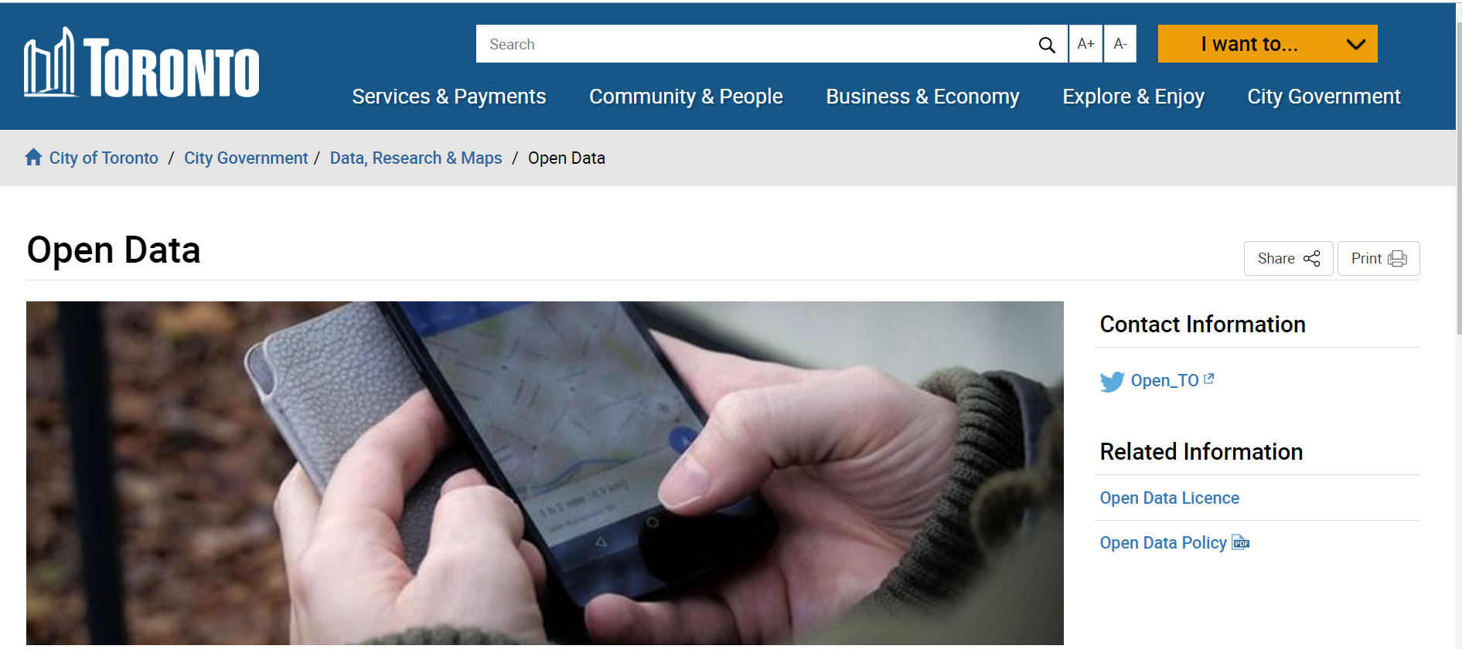

Driven by data from…
- The City of Toronto’s Open Data
https://open.toronto.ca/dataset/building-permits-cleared-permits-prior-years/
- Canada Mortgage and Housing Corporation (CMHC)
https://www03.cmhc-schl.gc.ca/hmip-pimh/en/TableMapChart/Table?TableId=2.2.11&GeographyId=2270&GeographyTypeId=3&DisplayAs=Table&GeograghyName=Toronto

Slide 5




From ‘raw’ to ‘awe’
.
Raw
Web browser
Awe

